Slide 1

Fast Food Pink Panther Crikvenica
Official Style Guide

Slide 2
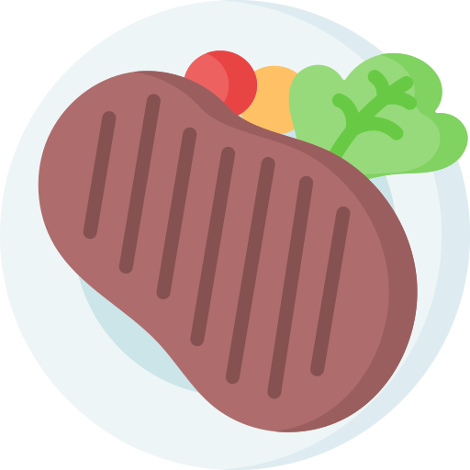

INTRODUCTION
Welcome to my first Style Guide of my first real solo project where I created a website for Fast Food Pink Panther Crkvenica

Slide 3
TABLE OF CONTENTS
01
02
03
Strategy
04
Typography
Purpose, personality, target audience and voice
Fonts and font scale used throughout the project
Logo
05
Application feel
Here
Here
Color standards
Colors used throughout the project

Slide 4
01
STRATEGY
Purpose, personality, target audience and voice

Slide 5
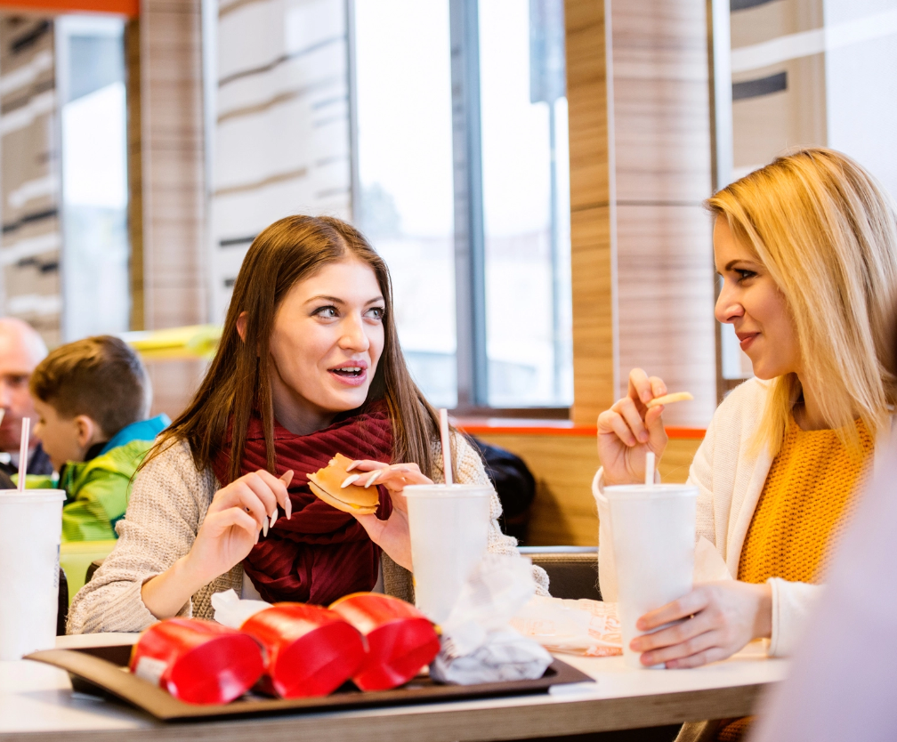
PURPOSE
Their purpose is to satisfy every guest who visits them
So that the guests, when they leave, spread the story about them and come back again

Slide 6
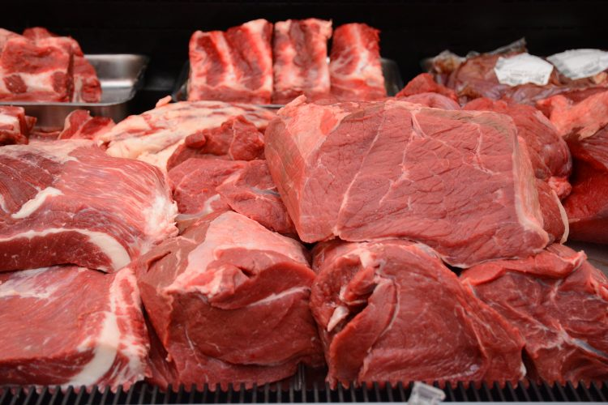
PERSONALITY
Their personality is based on the knowledge they like to enrich and the service they like to perform
They care about people and their health. That's why on their menu you can find only fresh foods and top quality local meat

Slide 7
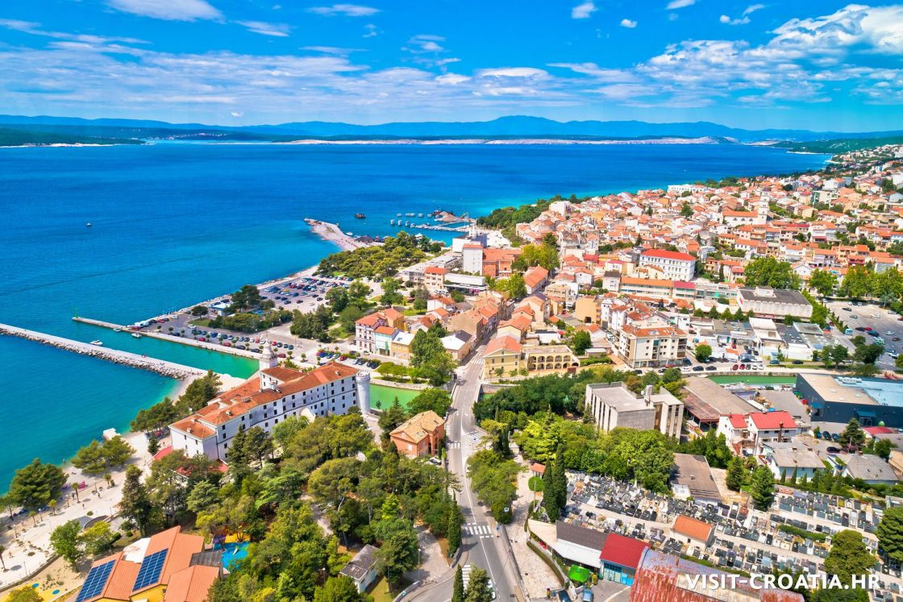
TARGET AUDIENCE
The target audience is tourists during the summer season, so for them there is a translation in 3 languages on the website
The residents of Crikvenica must also be mentioned, because of which fast food works all year round

Slide 8
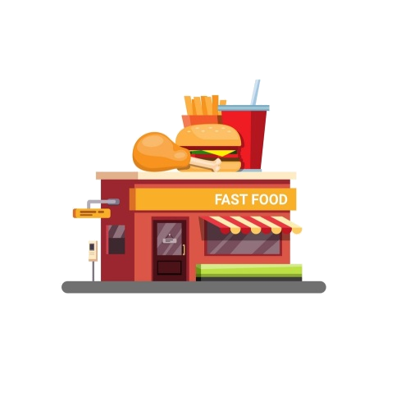

VOICE
Since all their employees are always polite, friendly and kind to all guests. Always helpful for all your requests and questions.
These qualities would be their voice, that is, what people see them as.

Slide 9
02
LOGO
You can enter a subtitle here if you need it

Slide 10

LOGO

Slide 11
LOGO CONCEPT
Mercury is the closest planet to the Sun and the smallest one in our Solar System—it’s only a bit larger than the Moon. The planet’s name has nothing to do with the liquid metal, since Mercury was named after the Roman messenger god

Slide 12
BRAND CONSTRUCTION
5px
5px
Venus has a beautiful name and is the second planet from the Sun. It’s terribly hot—even hotter than Mercury—and its atmosphere is extremely poisonous

Slide 13
CLEAR SPACE REQUIREMENTS
Despite being red, Mars is actually a cold place. It’s full of iron oxide dust, giving the planet its reddish cast

Slide 14
DIMENSIONS
25mm
15mm
150px
100px
60px
Print
Digital
Jupiter is a gas giant and the biggest planet of them all in the Solar System
Saturn is a gas giant and has rings. It’s composed mostly of hydrogen and helium

Slide 15
DOS
Here you can describe the correct uses of your logo
Here you can describe the correct uses of your logo
Here you can describe the correct uses of your logo

Slide 16
DON’TS
Here you can describe the incorrect uses of your logo
Here you can describe the incorrect uses of your logo
Here you can describe the incorrect uses of your logo

Slide 17
03
COLOR STANDARDS
Colors used throughout the project

Slide 18
COLOR STANDARDS
#F8F9FA
#FFC0CB
#F977AA
#F08080 #FF69B4
RGB: 248 249 250
RGB: 255 192 203
RGB: 249 119 170
RGB: 240 128 128
RGB: 255 105 180

Slide 19
COLOR GUIDELINES
CULTURED
PINK
CYCLAMEN
LIGHT CORAL & HOT PINK
Used for navbar and footer background
Used for cards body background
Used for buttons backround
Userd for prices background

Slide 20
04
TYPOGRAPHY
Fonts and font scale used throughout the project

Slide 21
TYPOGRAPHY
Aa
Aa
EBGaramond-Regular
Aa Bb Cc Dd Ee Ff Gg Hh Ii Jj Kk Ll Mm Nn Oo Pp Qq Rr Ss Tt Uu Vv Ww Yy Zz
Aa
EBGaramond-Italic
Aa Bb Cc Dd Ee Ff Gg Hh Ii Jj Kk Ll Mm Nn Oo Pp Qq Rr Ss Tt Uu Vv Ww Yy Zz
Desigers
Aa Bb Cc Dd Ee Ff Gg Hh Ii Jj Kk Ll Mm Nn Oo Pp Qq Rr Ss Tt Uu Vv Ww Yy Zz

Slide 22
Aa
Aa
Aa
Desigers
Used for page headings and prices
Official Pink Panther font
EBGaramond Regular
EBGaramond Italic
Used for everything
Used for food
description in menu

Slide 23
FONT SCALE
Font scale used in this project is Major Third:
61.04px
48.83px
39.06px
31.25px
25.00px
20.00px
16.00px
Used for heading on home page
Used for headings of pages
Used for heading of main sections
Used for quotes and some subheadings of sections
Used mostly for buttons and card headings
Used for navbar links and prices
Used for descriptions, most often in cards

Slide 24
05
APPLICATION FEEL
You can enter a subtitle here if you need it

Slide 25
Light mode je zbog toga sto je najposjecenije u doba sezone kad su skoro uvijek jako suncani dani pa da se oci ne umaraju dok gledaju u mobitel
Aplikacija je radena tako da je na prvom mjestu da mora biti prilagodena svim mobilnim uredajima bas zbog hrane, mora i sezone..

Slide 26

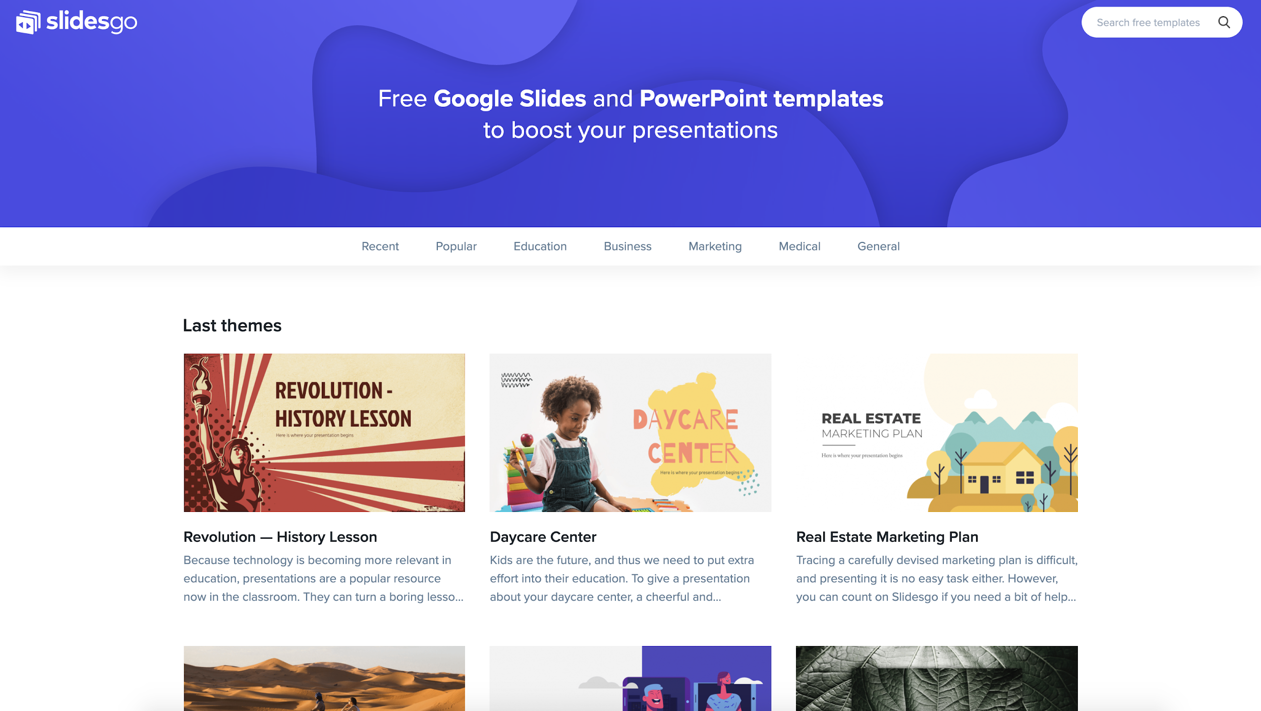
Mockup
You can replace the image on the screen with your own work. Just delete this one, add yours and center it properly

Slide 27
ICONOGRAPHY

Slide 28
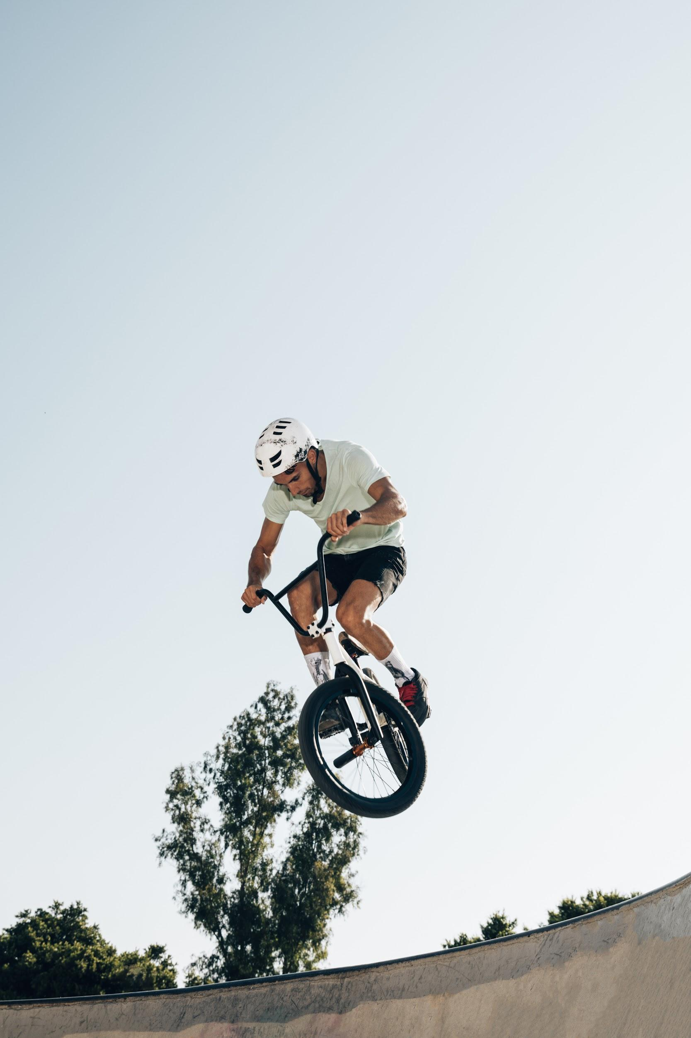
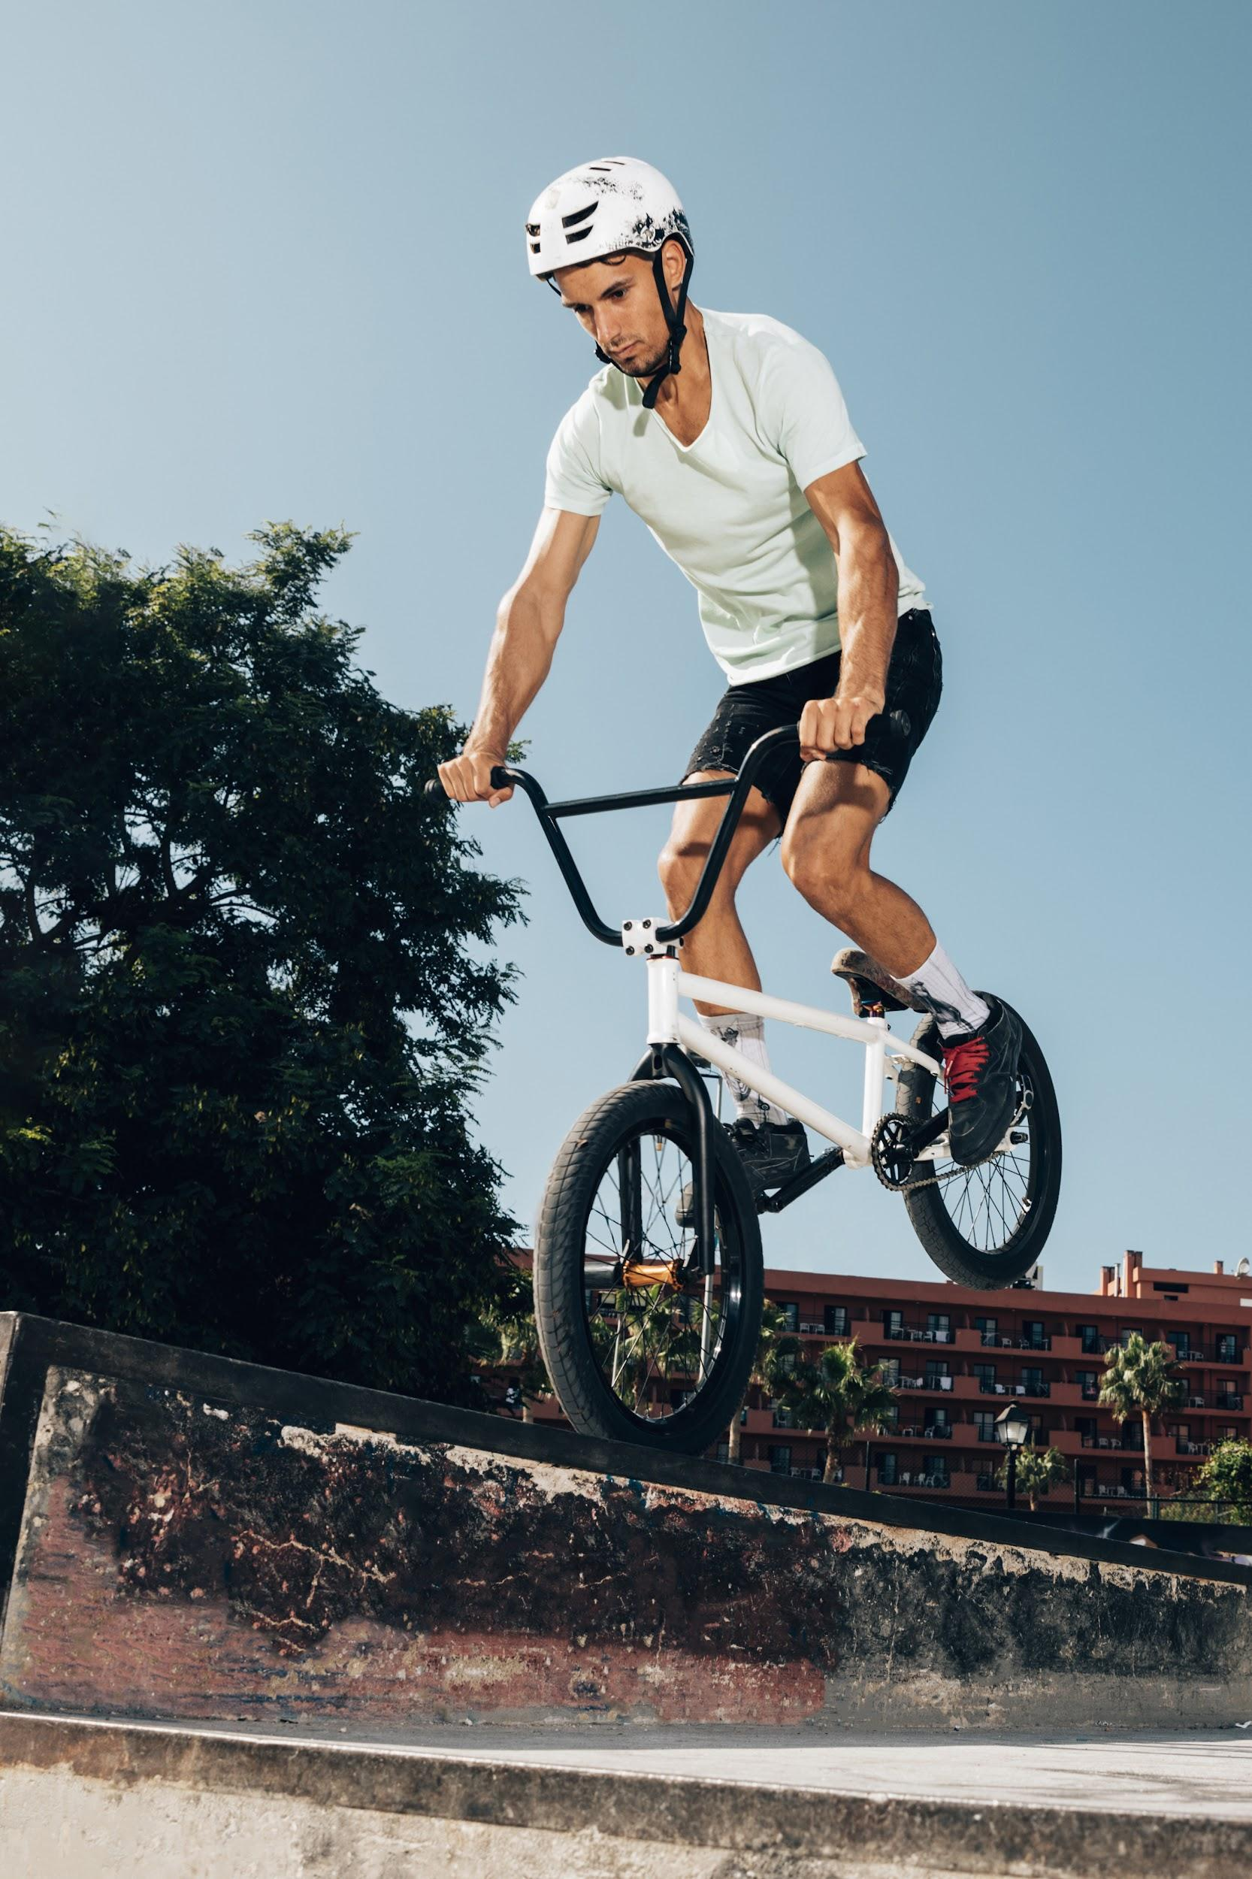
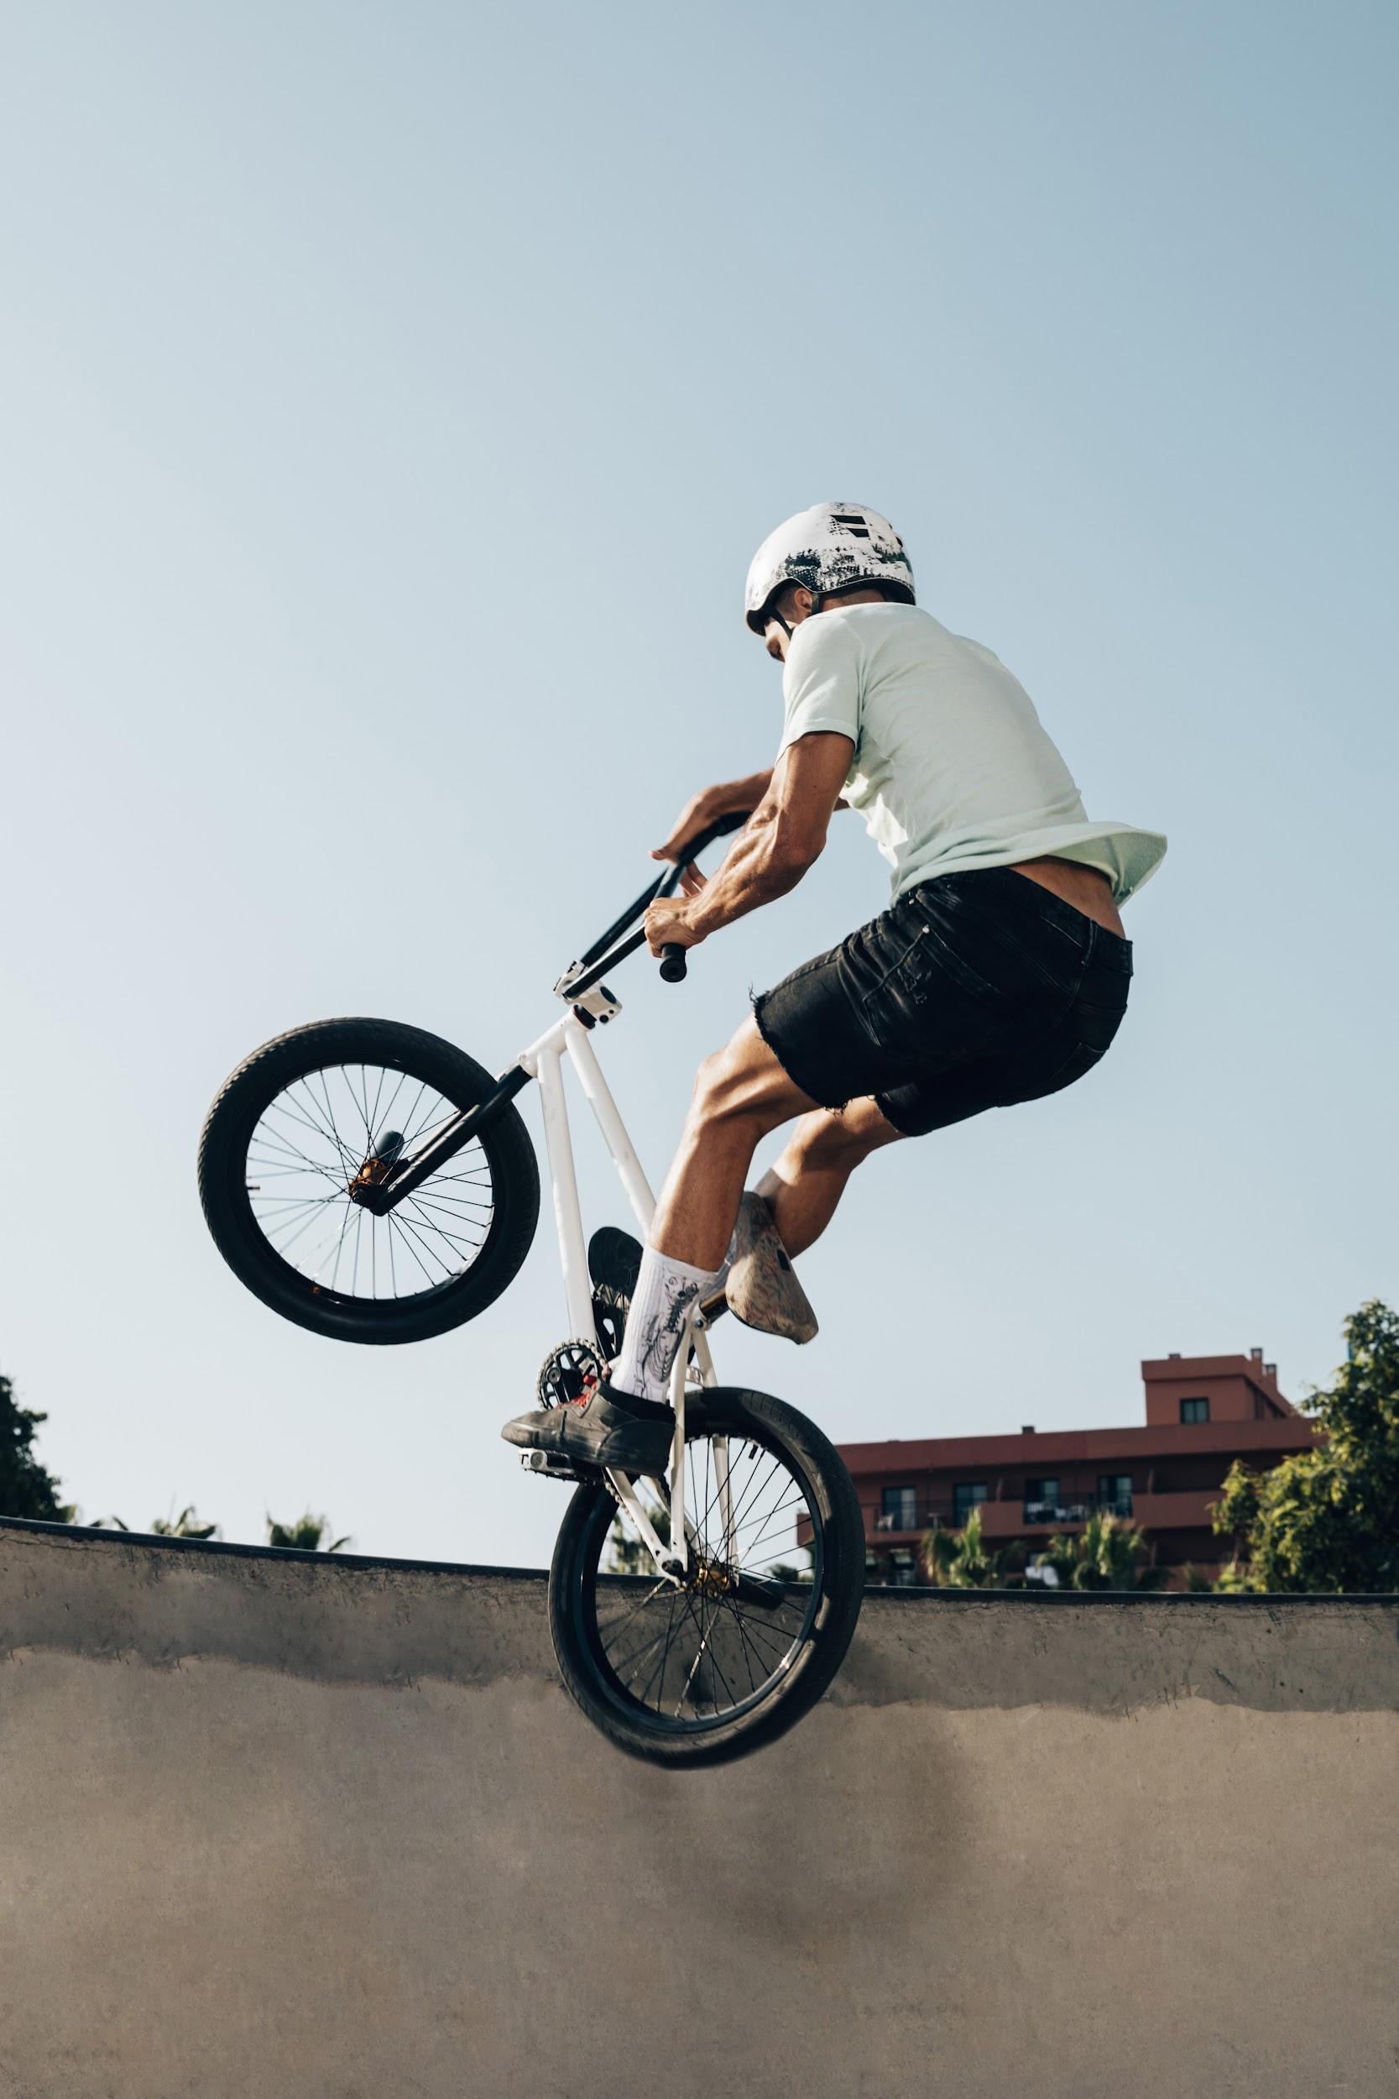

IMAGE GUIDELINES
Venus has a beautiful name and is the second planet from the Sun. It’s terribly hot, even hotter than Mercury

Slide 29
IMAGE CONCEPT
Mercury is the closest planet to the Sun and the smallest one in the Solar System—it’s only a bit larger than the Moon

Slide 30
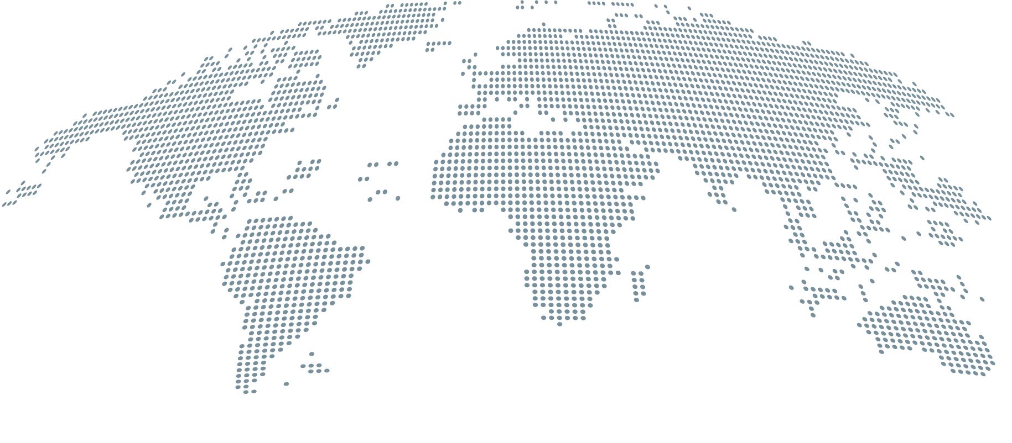
HEADQUARTERS
Jupiter
Jupiter is the biggest planet in the Solar System
Mars
Despite being red, Mars is actually a cold place

Slide 31
OUR HISTORY
1
2
3
4
Venus is the second planet from the Sun
Saturn is a gas giant and has several rings
Despite being red, Mars is a cold place
Mercury is the closest planet to the Sun

Slide 32

“This is a quote, words full of wisdom that someone important said and can make the reader get inspired.”
—Someone Famous

Slide 33
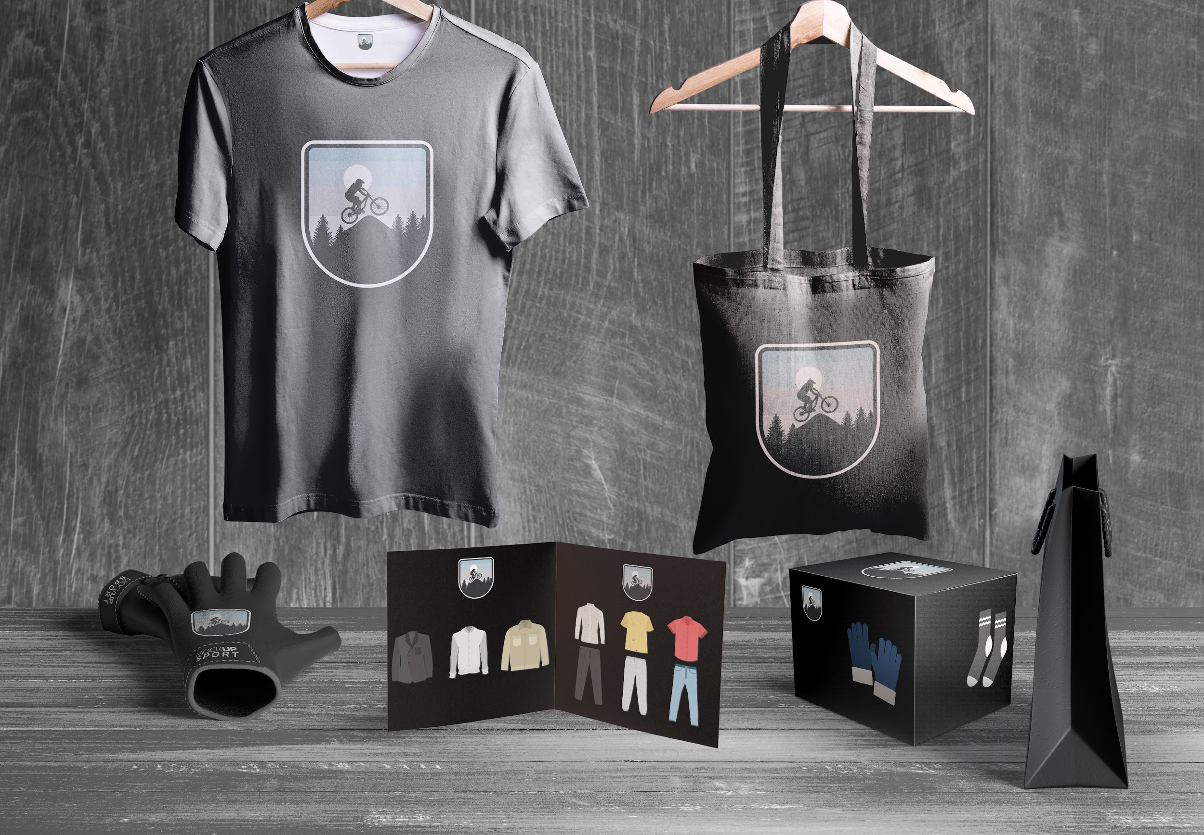
APPLICATIONS
Venus is a planet with a beautiful name and is the second one from the Sun. It’s terribly hot and its atmosphere is poisonous

Slide 34
THANKS!
Do you have any questions? youremail@freepik.com +91 620 421 838 yourcompany.com
Please keep this slide for attribution.

